Slide 1
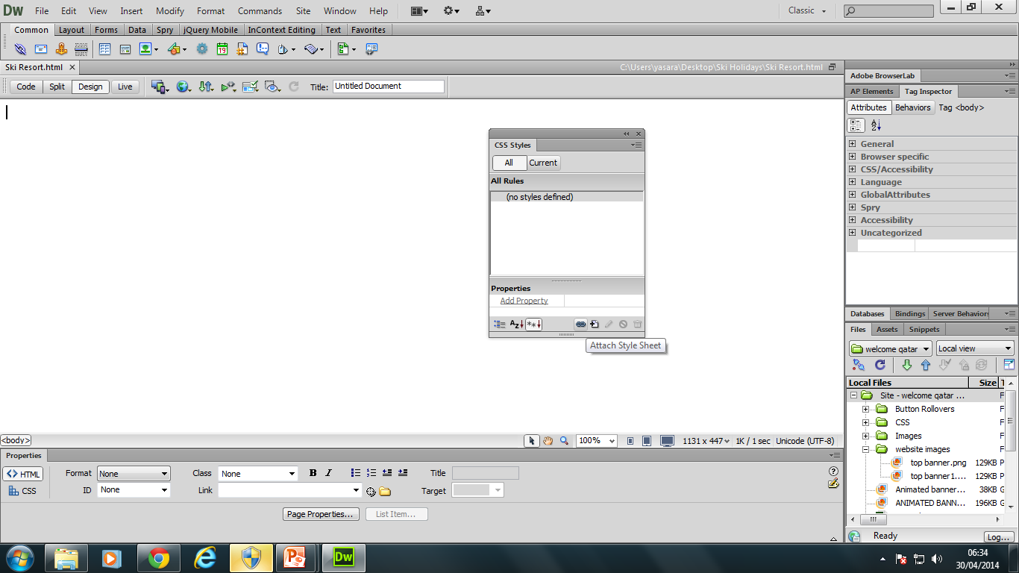
Web Authoring (Ski Resort Task)
Task 2 – Create new HTML and attach stylesheet
Create a new a HTML page called Ski Resort and save it into the root folder. Use the CSS Window to attach the style sheet you created in Task 1. Update CSS Format the body Tag so that the background image is selected.
800px
Table 1
Width: 800 px,
Height – 600px
Columns E & D – 200px
A | B
C |  | D
 |  | E | F
 |  | G | H
 |  | I | J
 |  | K | L
700px
600px
500px
400px
Table 2 (Place below table 1)
Width: 100% (Fit the Browser Window)

